Slide 1
Convolution Neural Network
201920951 Dept. of Software JuannKim

Slide 2

How can computer recognizes a image?
Aritificial Neural Network
Convolution Neural Network

Slide 3

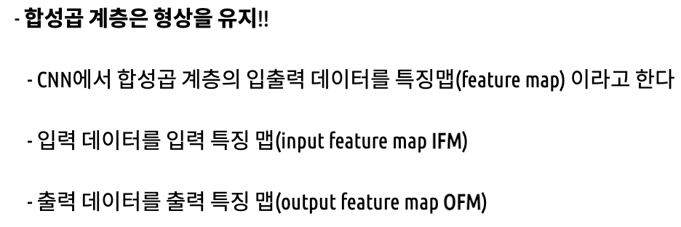
Fully Connected Layer & Convoultion Neural Network
Image에는 CNN !!!
2x2 matrix 최적 !!!

Slide 4
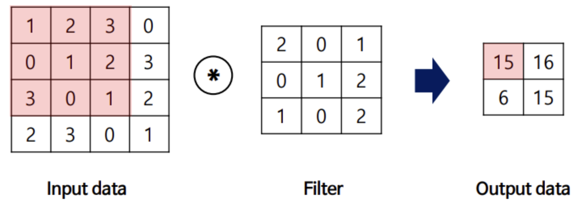
Convolution Operation (Filter operation in image)

Slide 5
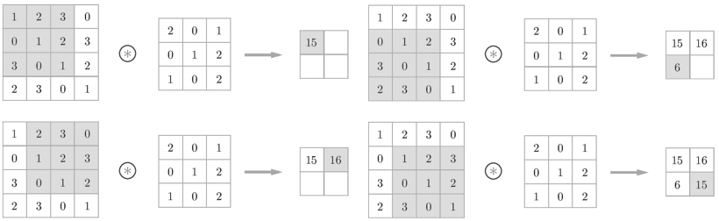
Convolution Operation (Filter operation in image)

Slide 6
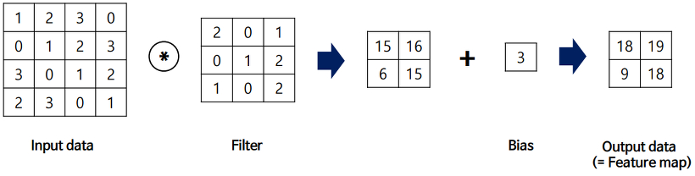
Convolution Operation (Filter operation in image)

Slide 7
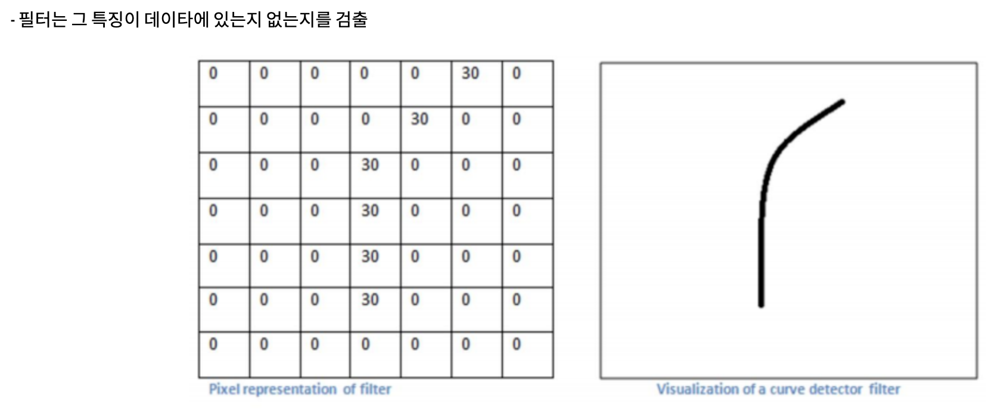
Convolution’s Effect

Slide 8
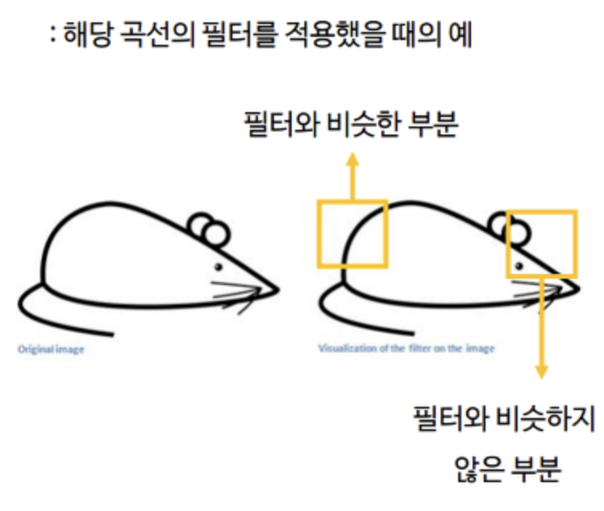
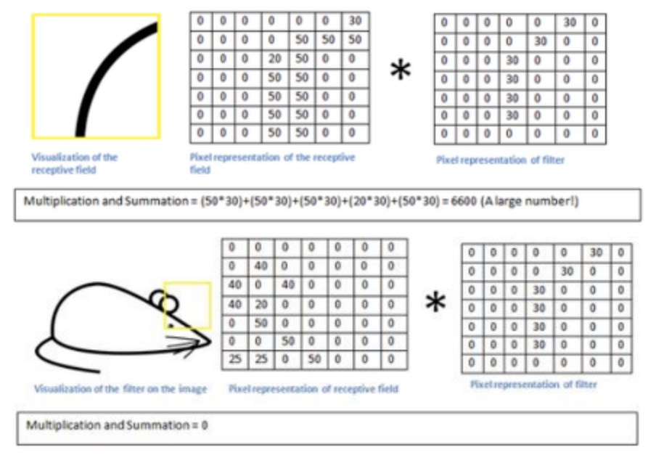
Convolution’s Effect

Slide 9
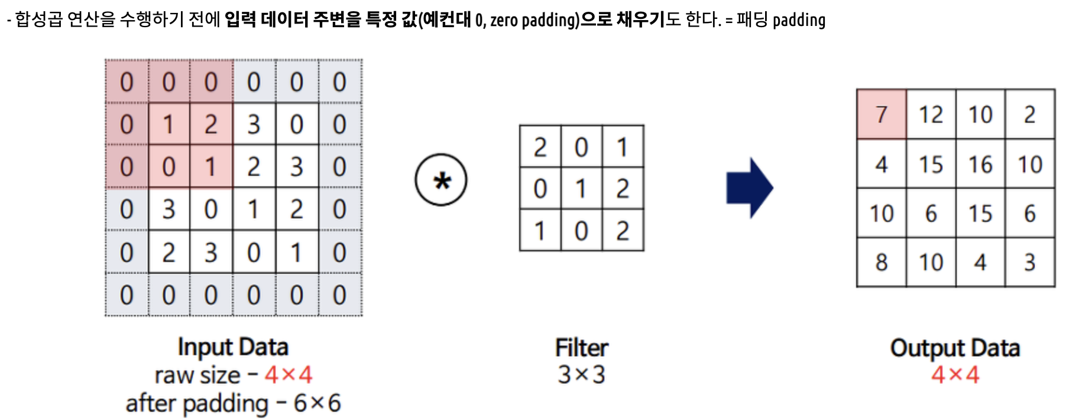
Padding
It makes Adjust printing size

Slide 10
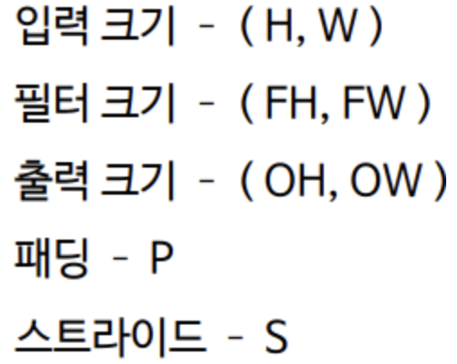
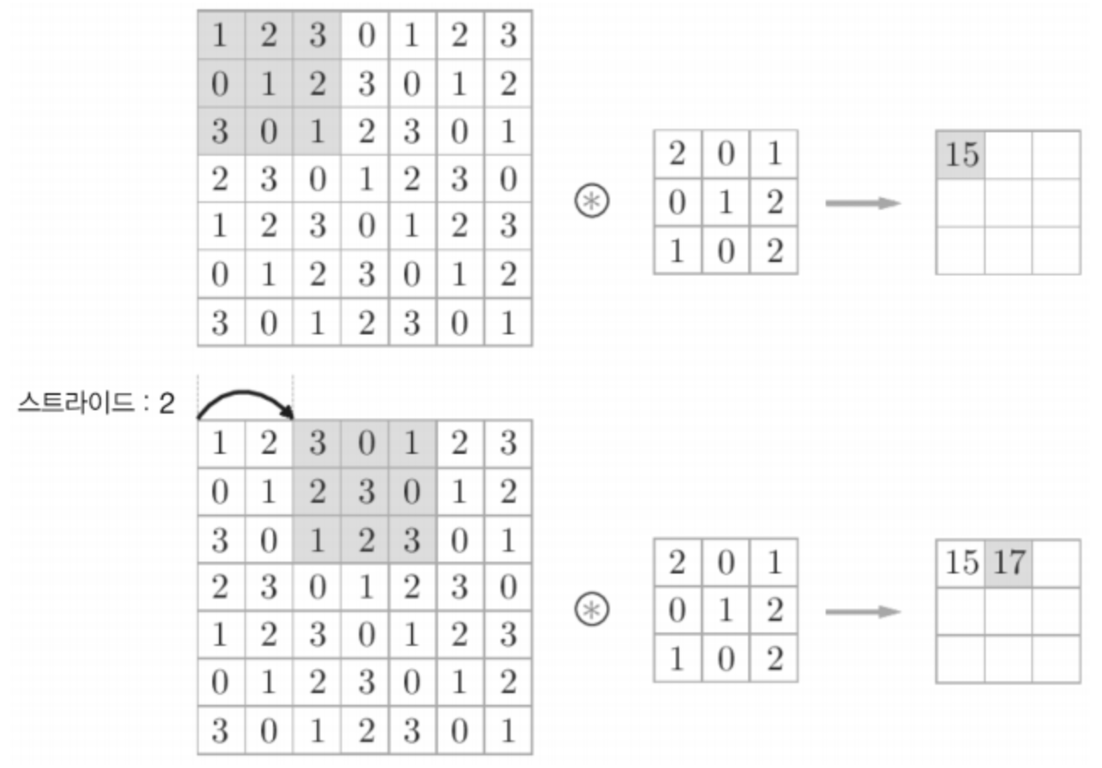
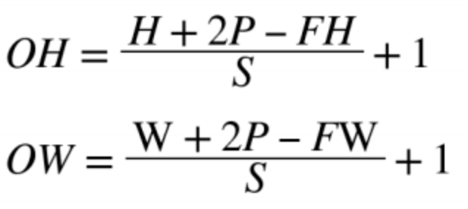
Stride
adventage

Slide 11
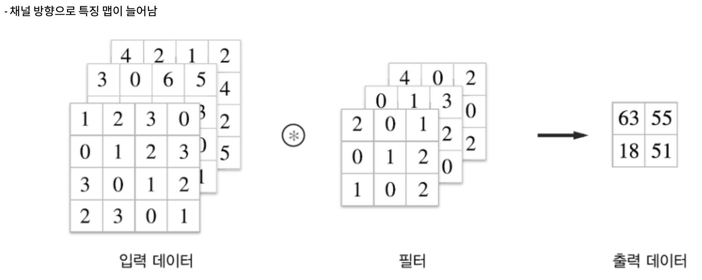
3D Data Convolution Operation

Slide 12
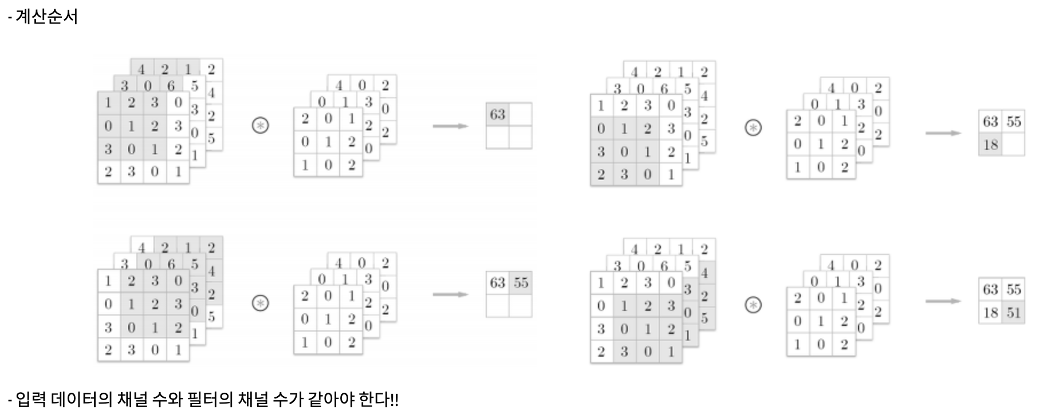
3D Data Convolution Operation

Slide 13
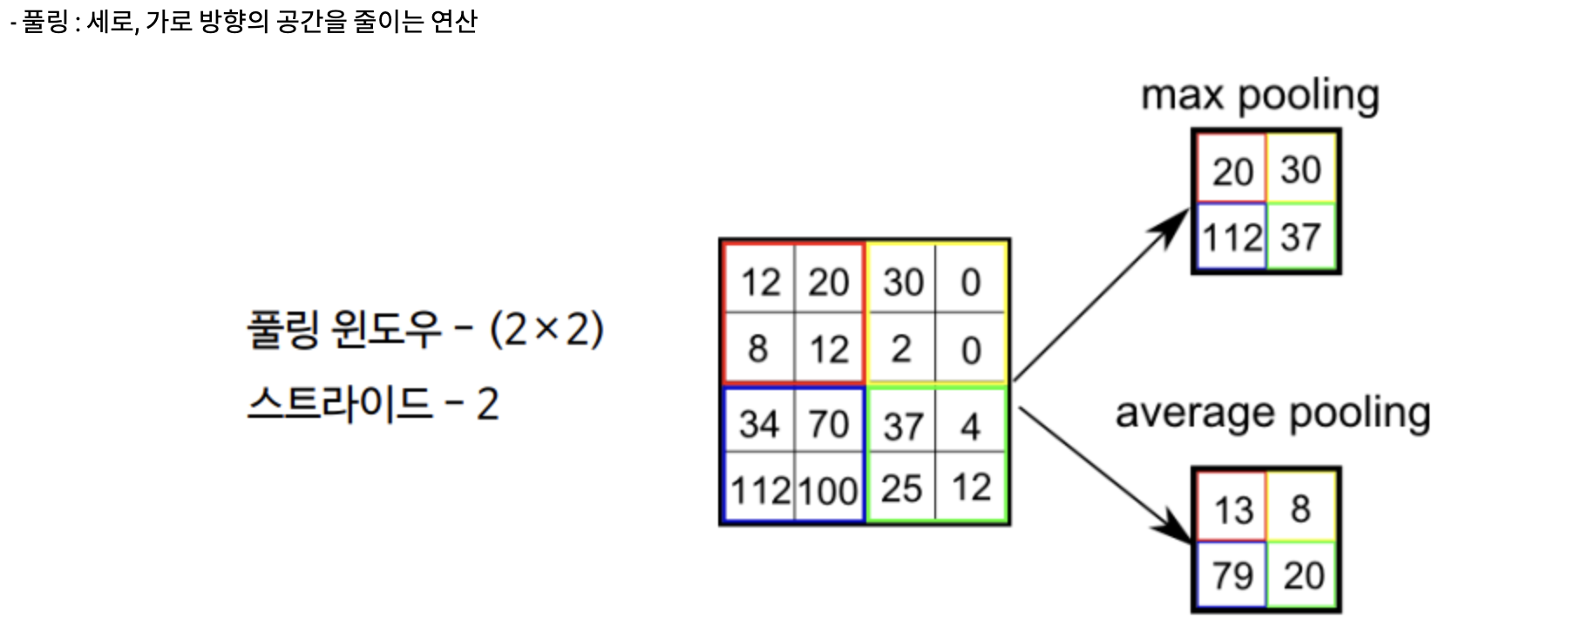
Pulling Layer

Slide 14
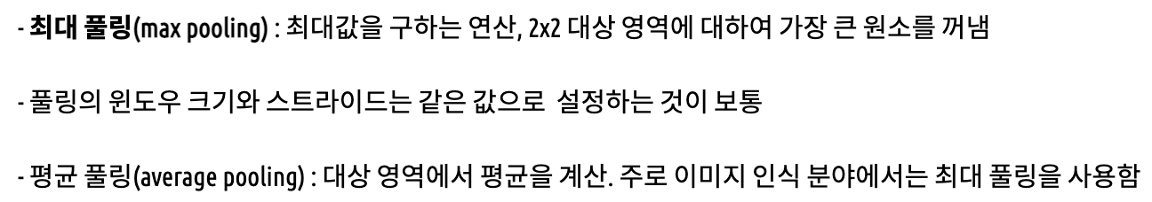
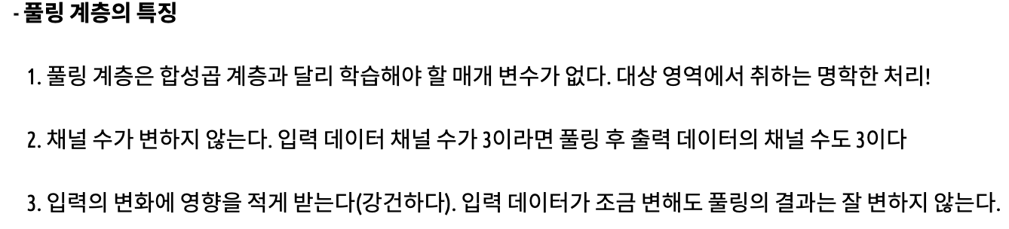
Pulling Layer

Slide 15
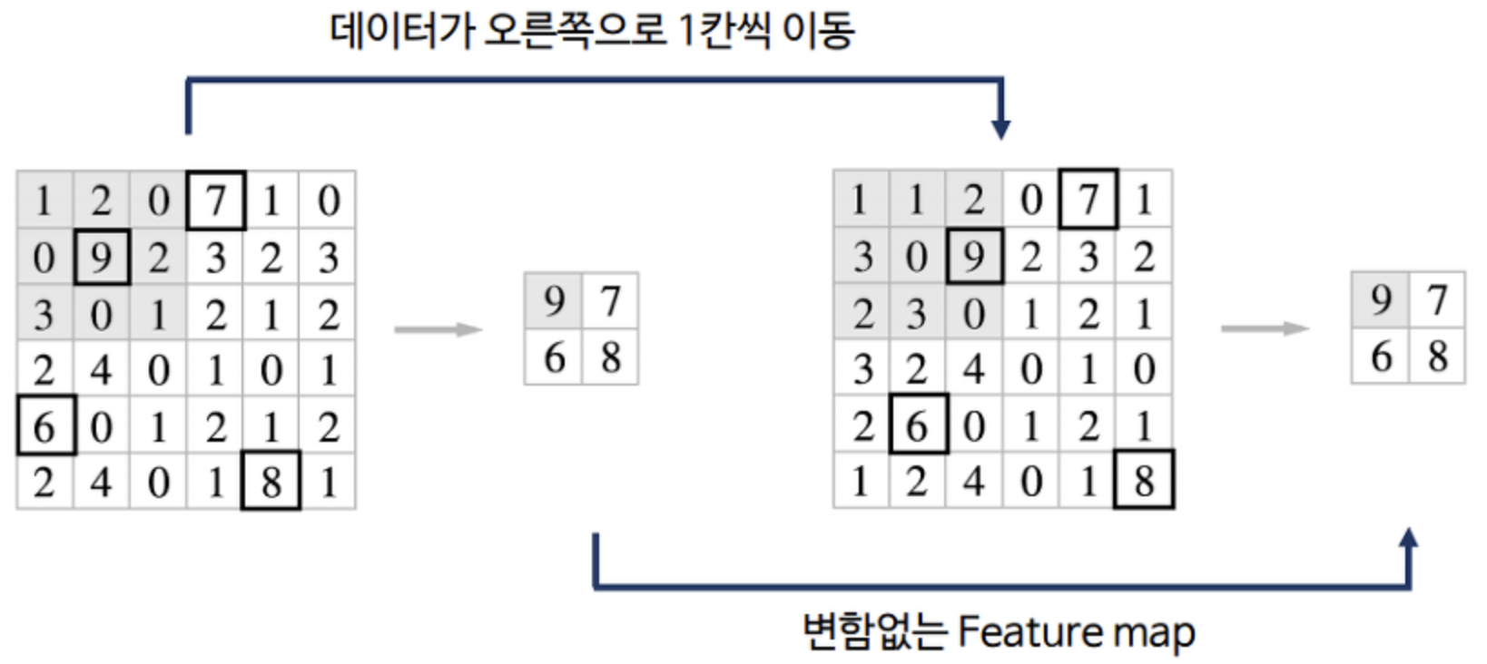
Pulling Layer

Slide 16
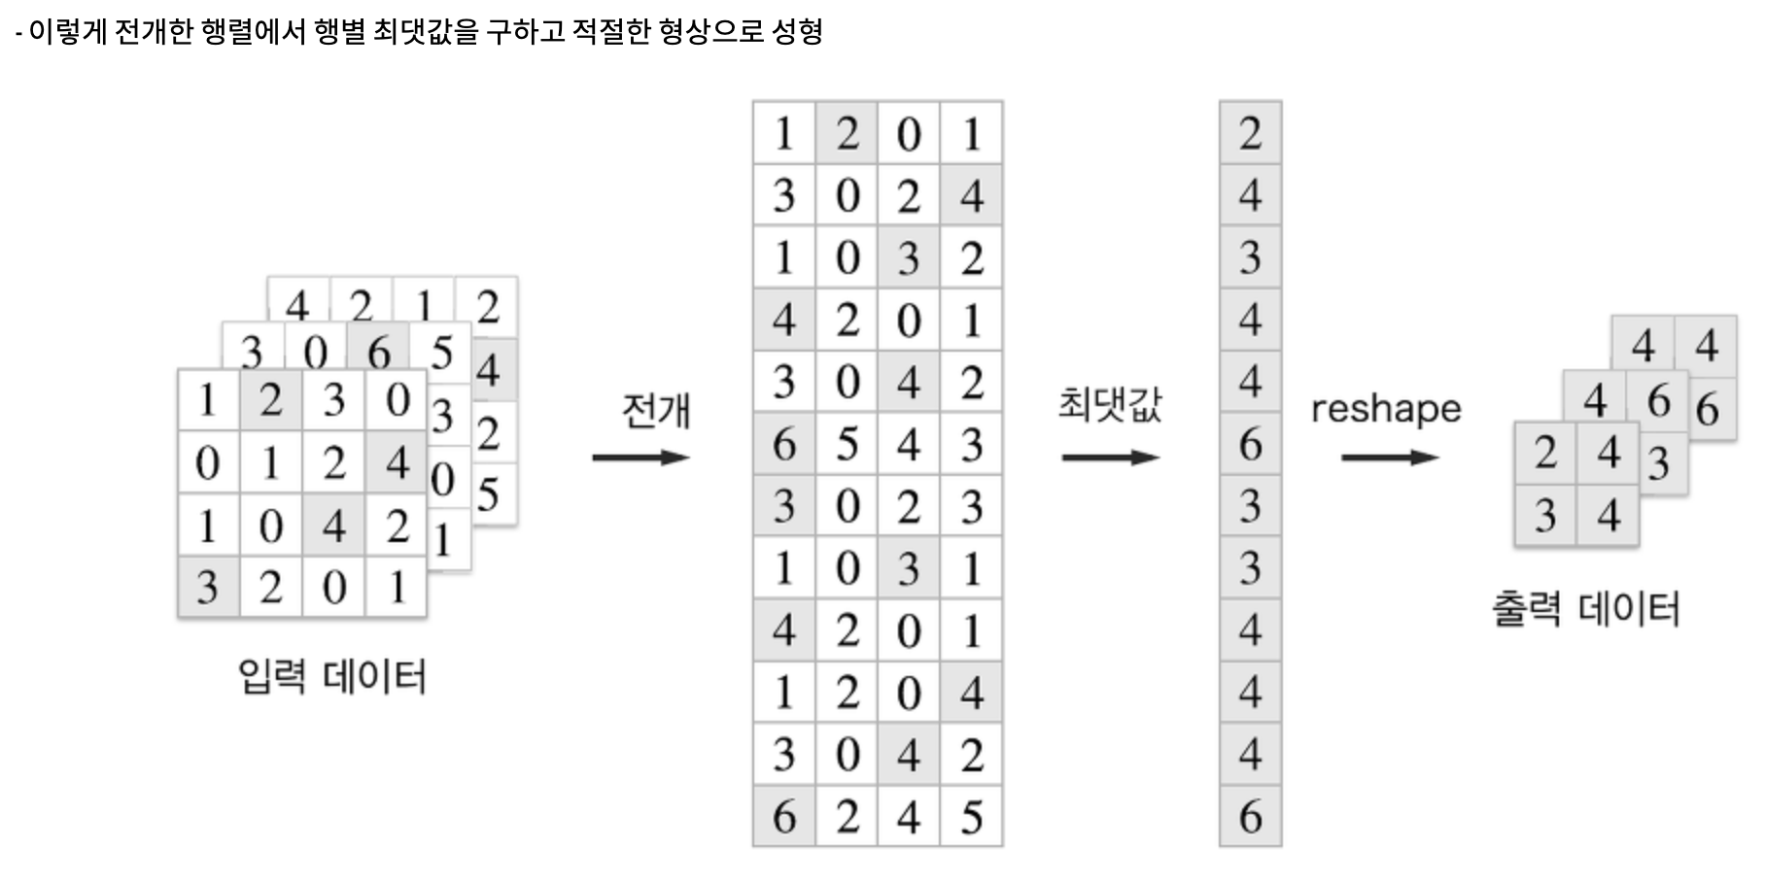
Fully Connected Layer

Slide 17
Thanks for watching
201920951 Dept. of Software JuannKim
http://taewan.kim/post/cnn/

